Slide 1

Programming GPUs with CUDA:
memory, grid size & error handling
Lara Querciagrossa, Andrew Emerson, Nitin Shukla, Luca Ferraro, Sergio Orlandini
l.querciagrossa@cineca.it
July 12th, 2022

Slide 2


In this lecture…
CUDA memory
Grid size vs data size
Error handling

Slide 3


CUDA memory

Slide 4
Unified Memory
Unified Memory since CUDA 6+
How to allocate and free memory
How to obtain a pointer that can be referenced in both host and device code
int N = 10000;
size_t size = N * sizeof(int);
int *a;
a = (int *)malloc(size);
free(a);
int N = 10000;
size_t size = N * sizeof(int);
int *a;
cudaMallocManaged(&a, size);
cudaFree(a);
CPU
GPU
Notes:
Register = small amount of fast storage

Slide 5
Exercise: 6_double_element.cu
This program allocates an array, initialize it with integers on the host, double each of its value in parallel on the GPU, confirm whether or not the doubling operation were successfully (on the host).
Currently the program is not working: why?
Refactor the application so that array a is available for both host and device.
Free memory at a correctly.
Notes:
Register = small amount of fast storage

Slide 6
Manual device memory management
Worth using when it is known that data will only be accessed by the device or the host.
Can also be used to allow the use of non-default streams (spoiler!) for overlapping data transfers with computational work.
This approach shows clearly the three-step process:
copy data from host to device,
run work on device,
copy back data from host to device.
Notes:
Register = small amount of fast storage

Slide 7
Manual device memory management
Declare host and device arrays
Allocate device_a directly on the GPU
Allocate host_a on CPU, it is page-locked or pinned
Call the initialize function on the host (no page faulting, since memory is already on the CPU)
Copy array host_a on the CPU to device_a on the GPU
Launch kernel on the GPU using device_a
int *host_a, *device_a;
cudaMalloc(&device_a, size);
cudaMallocHost(&host_a, size);
initializeOnHost(host_a, N);
cudaMemcpy(device_a, host_a, size, cudaMemcpyHostToDevice);
kernel<<<blocks, threads>>>(device_a, N);
Notes:
Register = small amount of fast storage

Slide 8
Manual device memory management
Copy results back from GPU (device_a) to CPU memory into host_a array
Verify results on host_a array on CPU
Free memory both on GPU and pinned one on CPU
cudaMemcpy(host_a, device_a, size, cudaMemcpyDeviceToHost);
verifyOnHost(host_a, N);
cudaFree(device_a);
cudaFreeHost(host_a);
Notes:
Register = small amount of fast storage

Slide 9
Exercise: 7_double_element_manual_memory_management.cu
Start from the solution of the exercise 6 and replace the usage of unified memory with manual memory management.
Notes:
Register = small amount of fast storage

Slide 10
Grid size vs data size

Slide 11
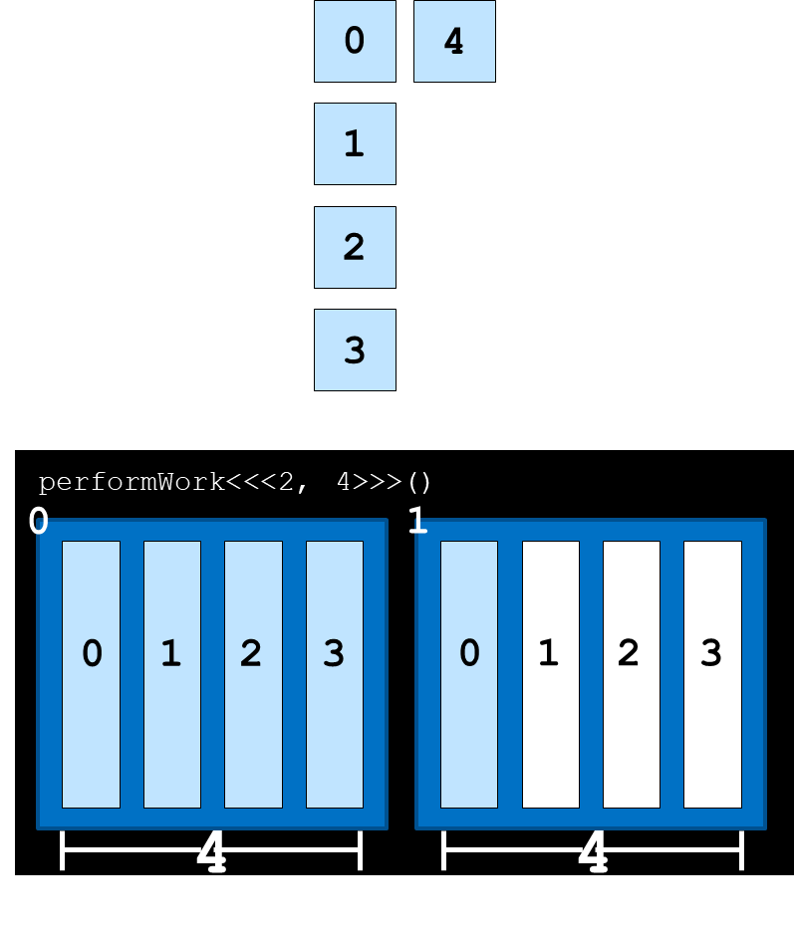
Grid size larger than data set
What happens if there are more threads than work to be done? Or if we cannot express the exact number of threads with any execution configuration?
Notes:
Register = small amount of fast storage

Slide 12
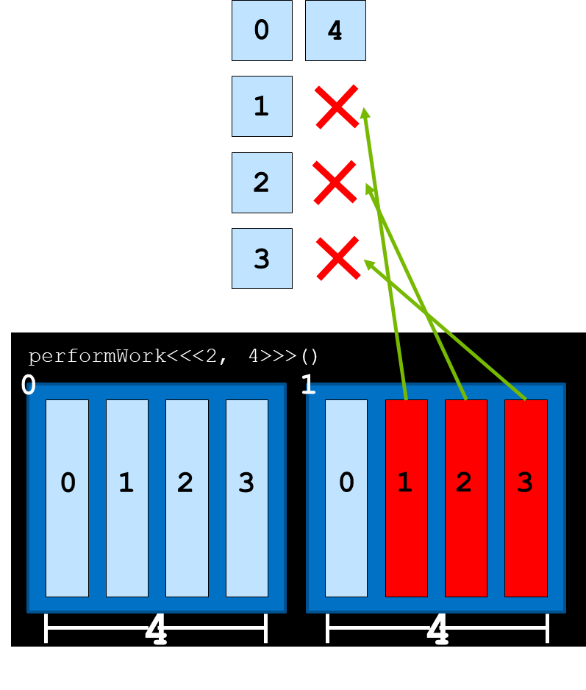
Grid size larger than data set
What happens if there are more threads than work to be done? Or if we cannot express the exact number of threads with any execution configuration?
Attempting to access non-existing elements can result in a runtime error
Kernel should work only if global index is smaller than total number of elements in the array
if (globalId < N)
Notes:
Register = small amount of fast storage

Slide 13
Grid size larger than data set
Choose the optimal block size: best performance for blocks that contain a number of threads that are a multiple of 32, due to GPU hardware traits.
Example: we need to run 1000 parallel task with blocks containing 256 threads. How do we choose the optimal block size?
Write an execution configuration that creates more threads than necessary.
Pass a value as an argument into the kernel (N) that represents to the total size of the data set to be processed/total threads needed to complete the work.
Calculate the global index and if it does not exceed N perform the kernel work.
Notes:
Register = small amount of fast storage

Slide 14
Grid size larger than data set
How do we ensure that there a sufficient number of threads?
size_t threads_per_blocks = 256;
size_t number_of_blocks = (N + threads_per_block – 1) / threads_per_block;
kernel<<<number_of_blocks, threads_per_block>>>(N);
This ensures that there are always at least as many threads as needed for N, and only 1 additional block's worth of threads extra.
Notes:
Register = small amount of fast storage

Slide 15
Exercise: 8_mismatch_loop.cu
The program allocates memory (with cudaMallocManaged) for a 1000 element array of integers, and then tries to initialize all the values of the array in parallel using a CUDA kernel.
The values of N or the number of threads_per_block should not be modified.
1. Assign a value to number_of_blocks that will make sure there are enough threads.
2. Update the initializeElementsTo kernel to make sure that it does not attempt to work on data elements that are out of range.
Notes:
Register = small amount of fast storage

Slide 16
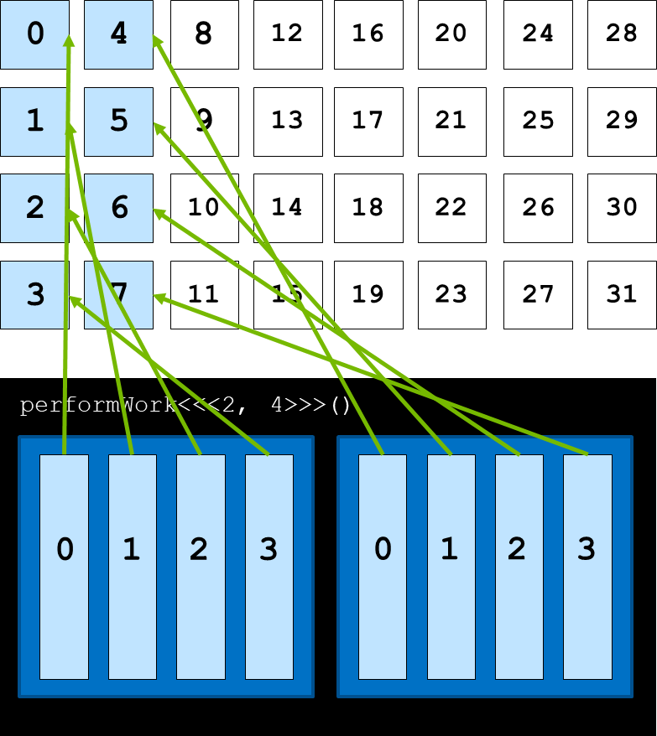
Data set larger than grid size: grid-stride loop
In this scenario, each threads should work on more elements.
Work can be assigned programmatically with a grid-stride loop
Notes:
Register = small amount of fast storage

Slide 17
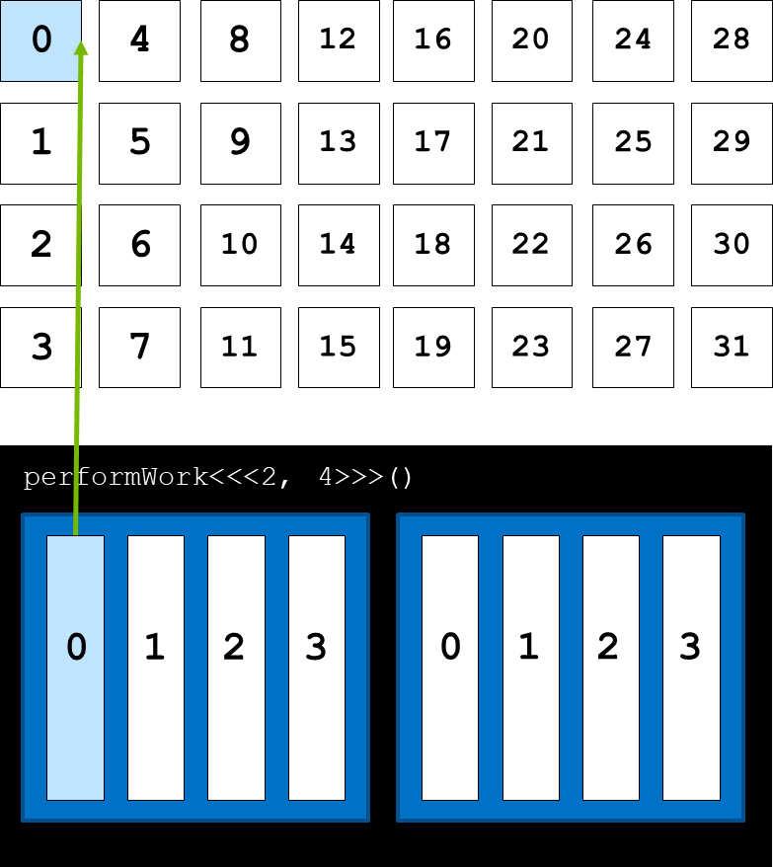
Data set larger than grid size: grid-stride loop
In this scenario, each threads should work on more elements.
Work can be assigned programmatically with a grid-stride loop:
the first element to be assigned to a thread is calculated via the global index
Notes:
Register = small amount of fast storage

Slide 18
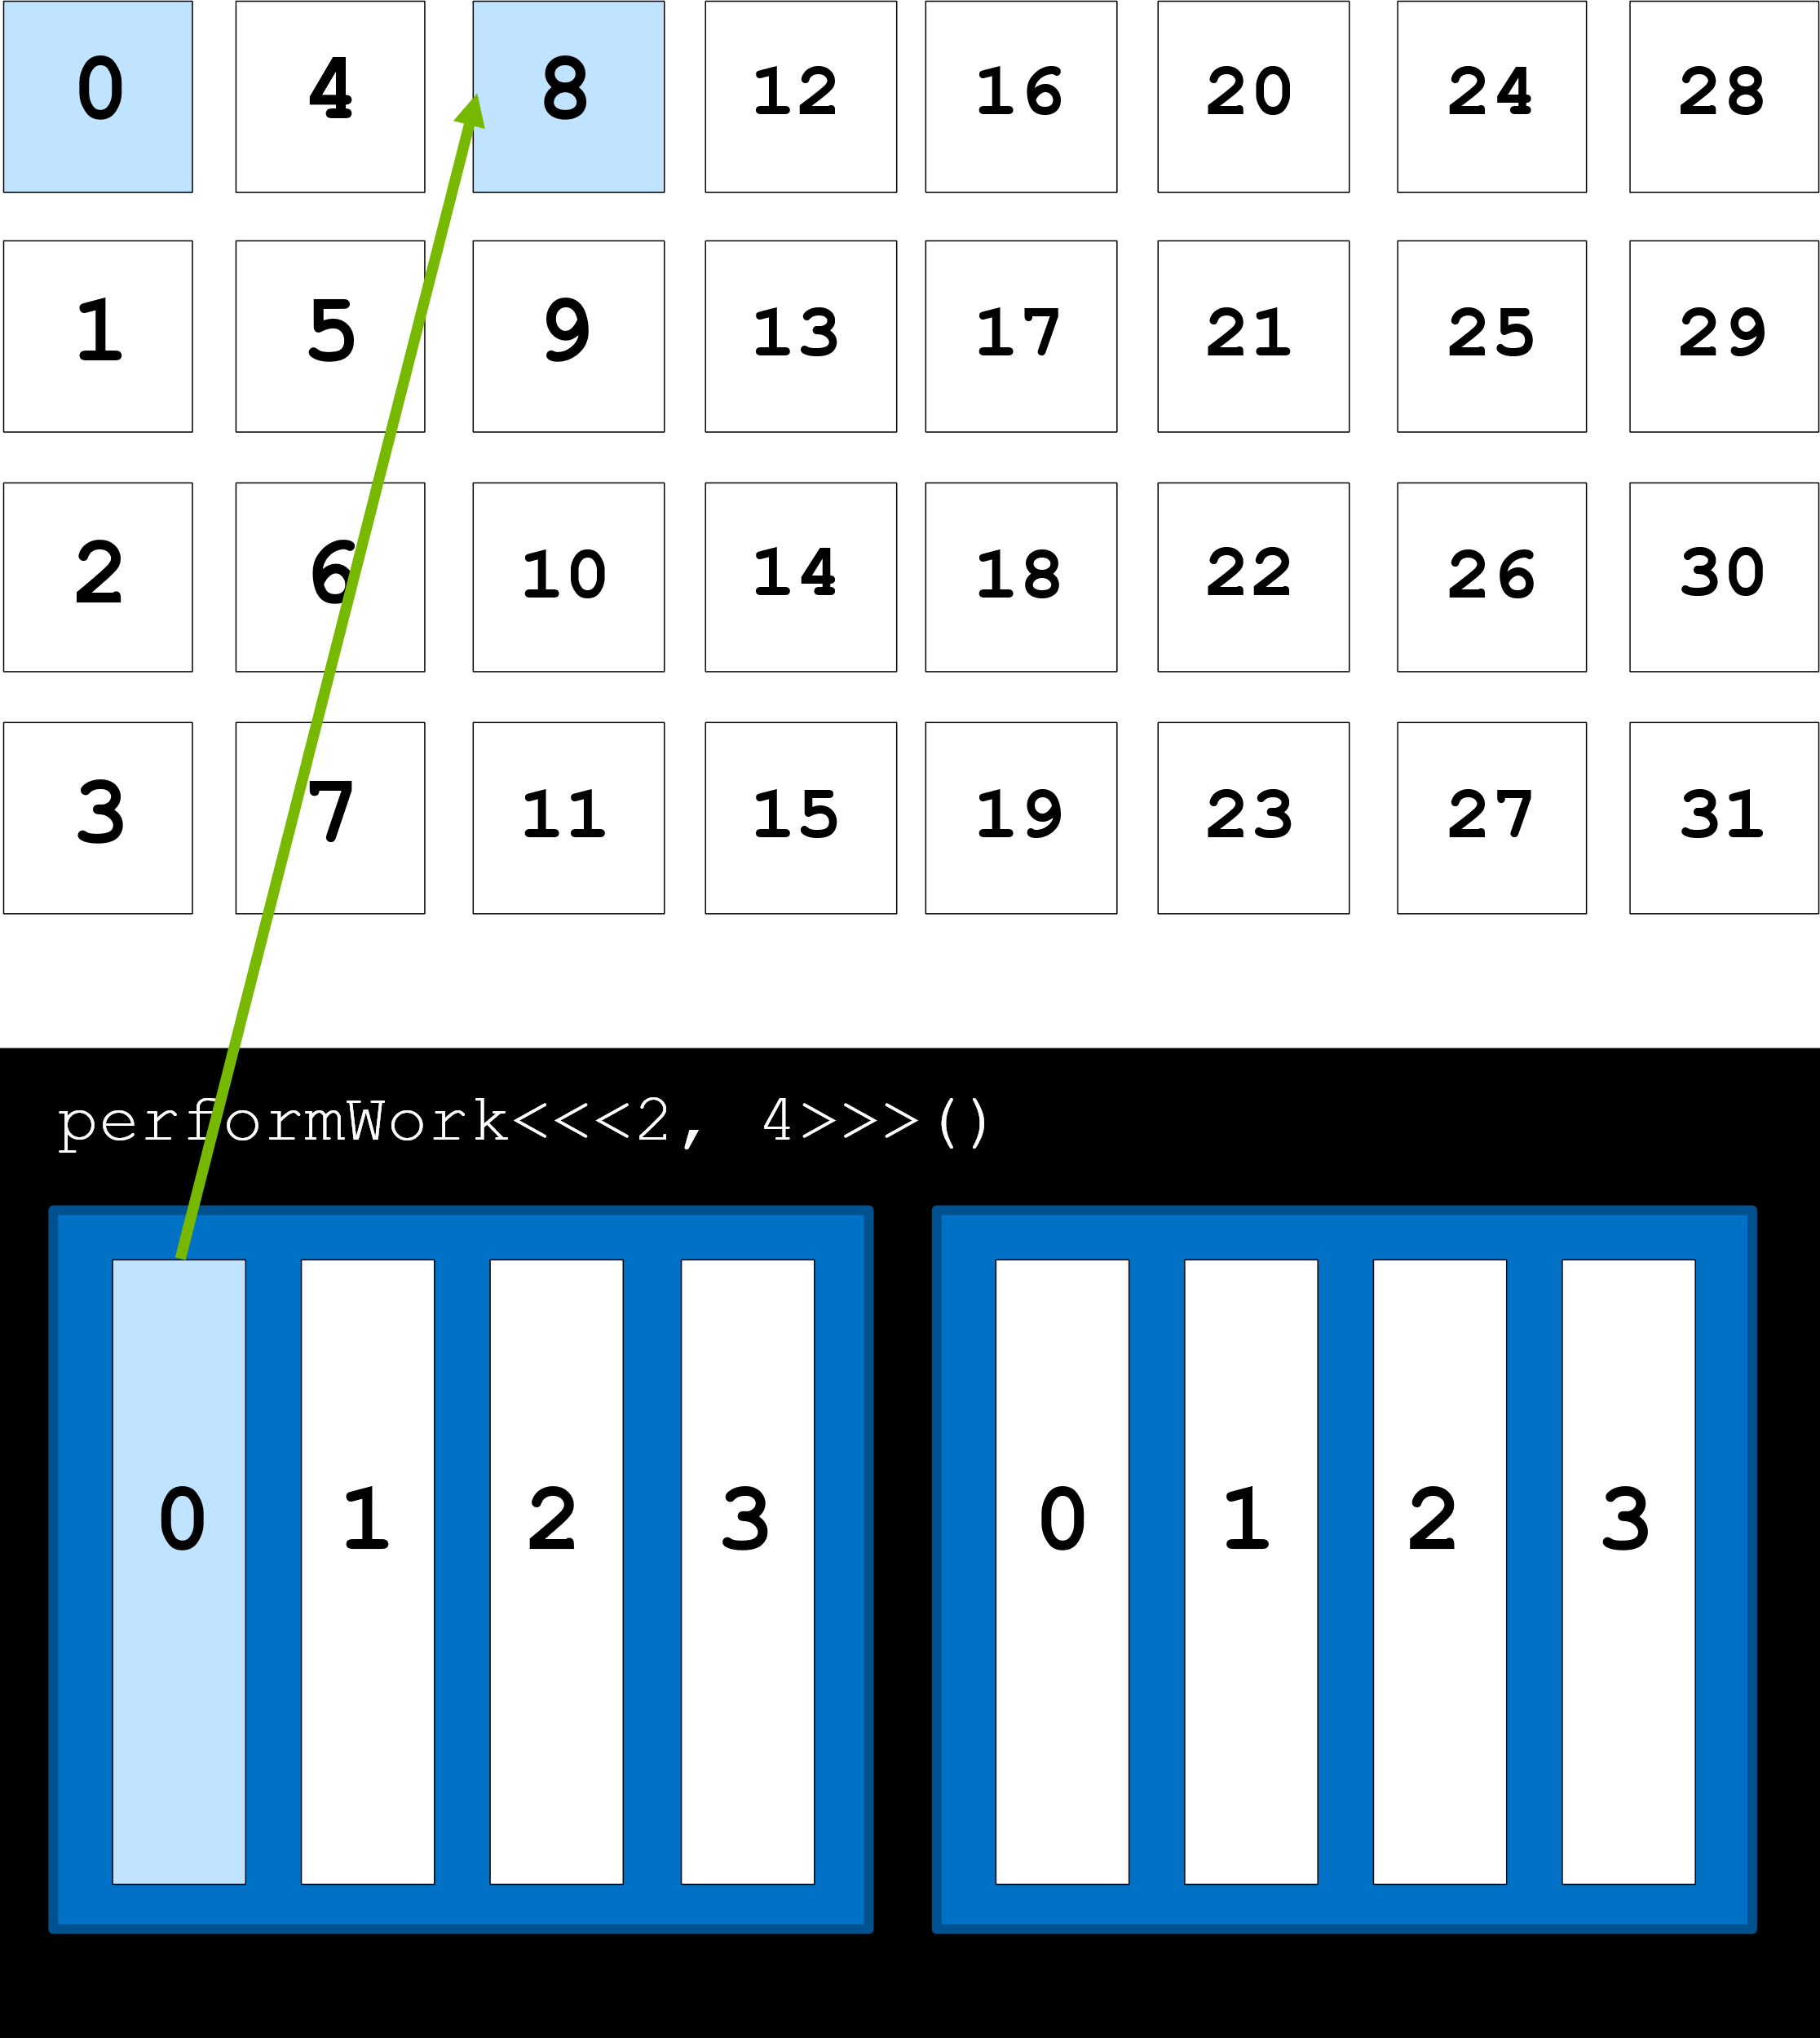
Data set larger than grid size: grid-stride loop
In this scenario, each threads should work on more elements.
Work can be assigned programmatically with a grid-stride loop:
the first element to be assigned to a thread is calculated via the global index,
the next one is obtained by summing the number of threads in the grid
stride = blockDim.x * gridDim.x
Notes:
Register = small amount of fast storage

Slide 19
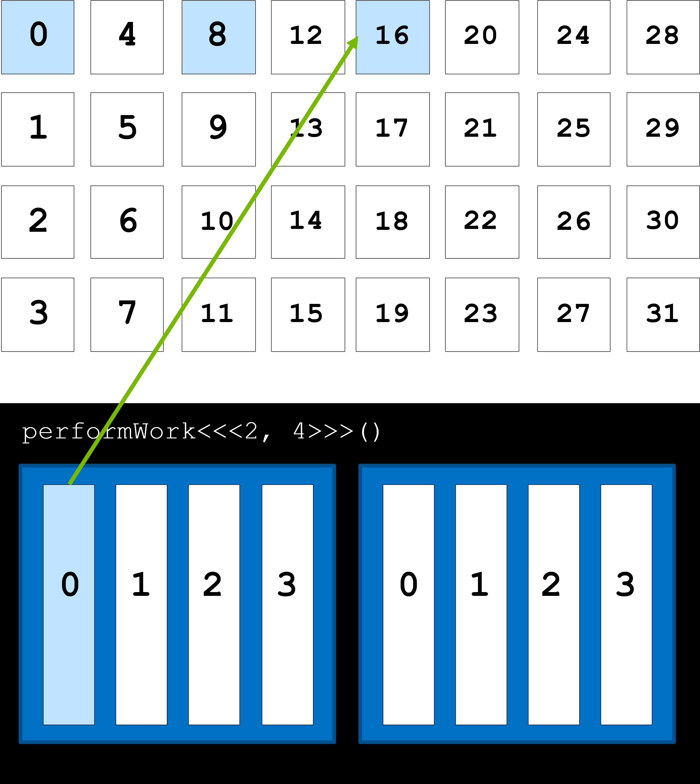
Data set larger than grid size: grid-stride loop
In this scenario, each threads should work on more elements.
Work can be assigned programmatically with a grid-stride loop:
the first element to be assigned to a thread is calculated via the global index,
the next one is obtained by summing the number of threads in the grid
stride = blockDim.x * gridDim.x
Notes:
Register = small amount of fast storage

Slide 20
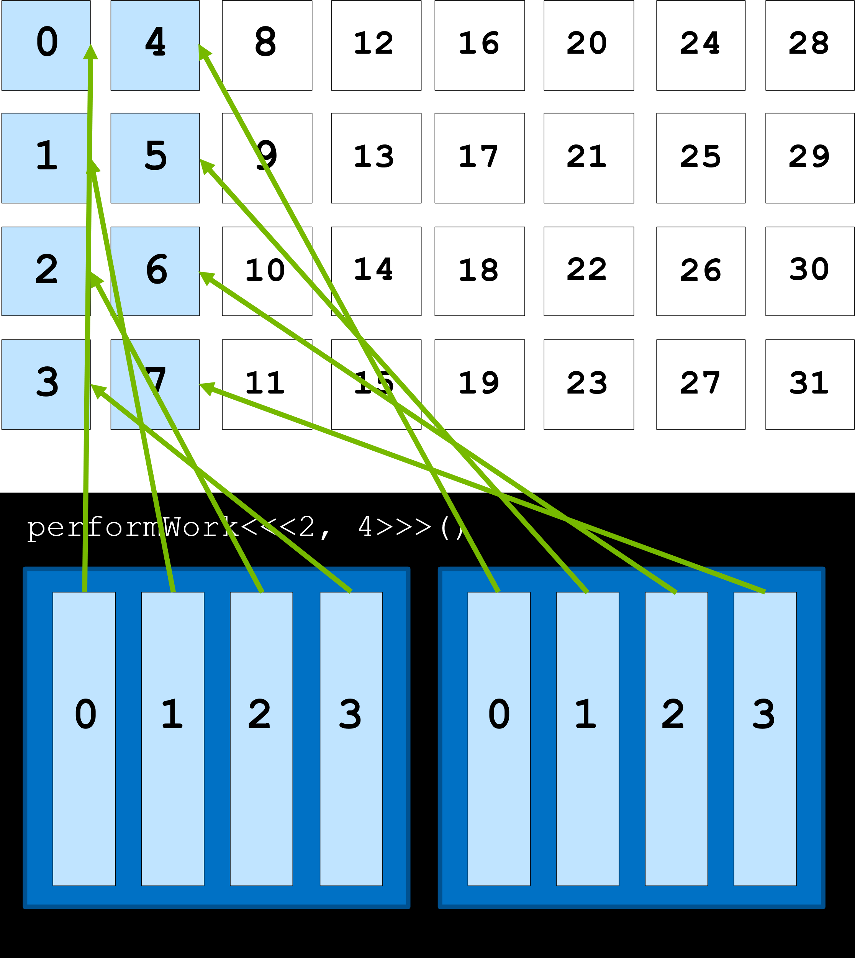
Data set larger than grid size: grid-stride loop
In this scenario, each threads should work on more elements.
Work can be assigned programmatically with a grid-stride loop:
the first element to be assigned to a thread is calculated via the global index,
the next one is obtained by summing the number of threads in the grid
stride = blockDim.x * gridDim.x
Notes:
Register = small amount of fast storage

Slide 21
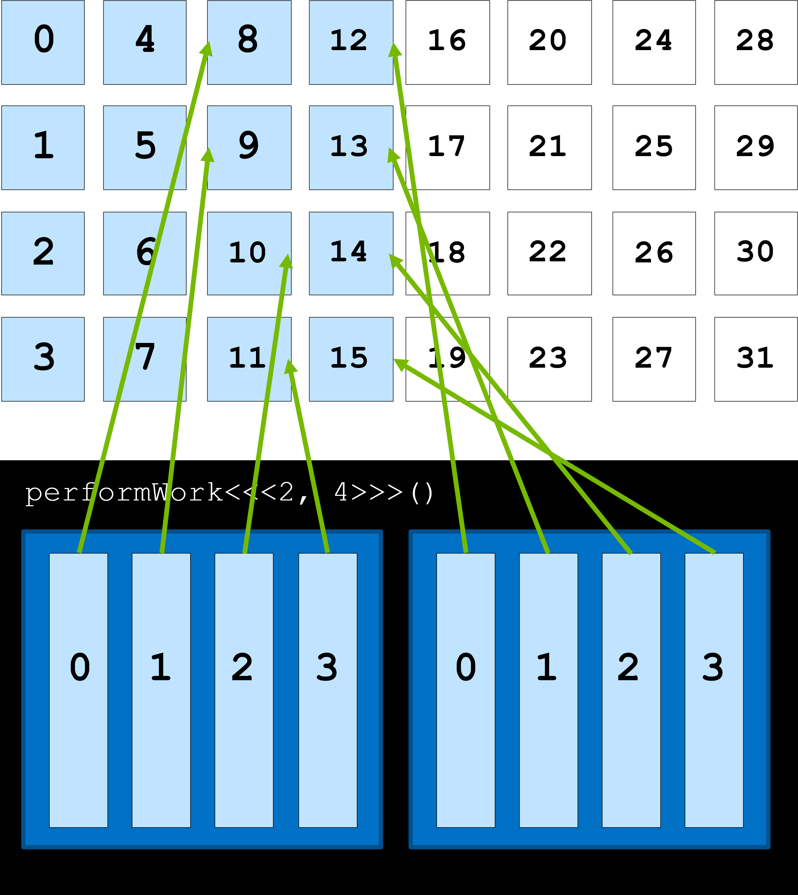
Data set larger than grid size: grid-stride loop
In this scenario, each threads should work on more elements.
Work can be assigned programmatically with a grid-stride loop:
the first element to be assigned to a thread is calculated via the global index,
the next one is obtained by summing the number of threads in the grid
stride = blockDim.x * gridDim.x
Notes:
Register = small amount of fast storage

Slide 22
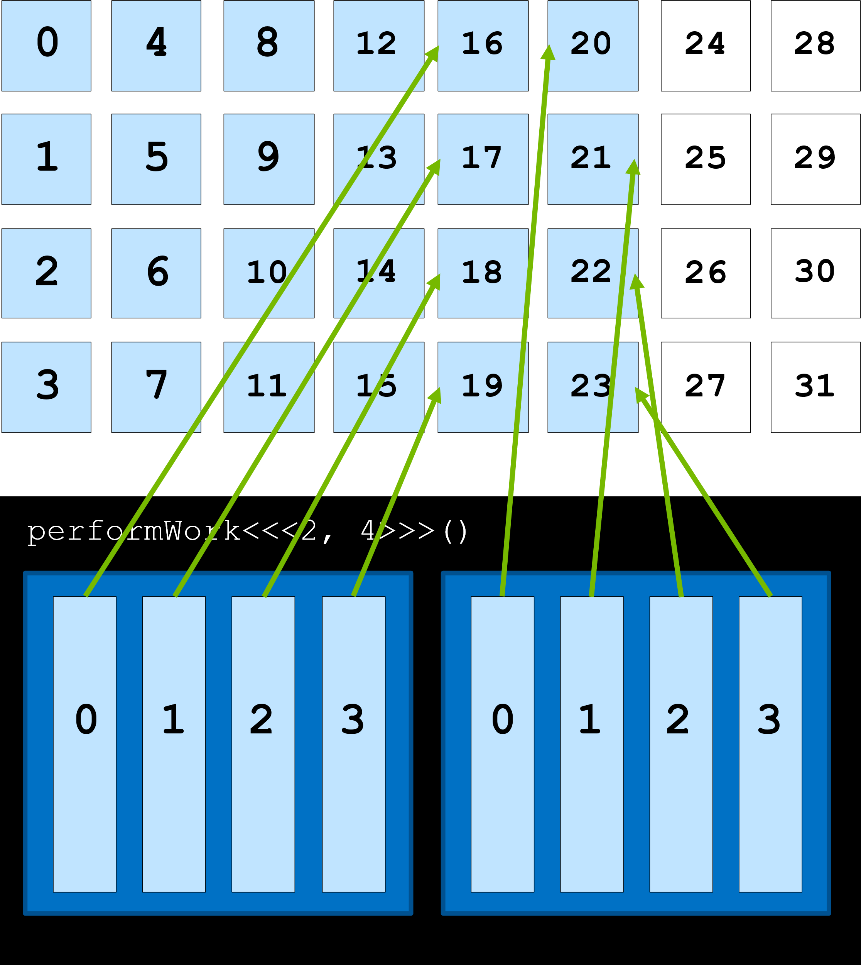
Data set larger than grid size: grid-stride loop
In this scenario, each threads should work on more elements.
Work can be assigned programmatically with a grid-stride loop:
the first element to be assigned to a thread is calculated via the global index,
the next one is obtained by summing the number of threads in the grid
stride = blockDim.x * gridDim.x
Notes:
Register = small amount of fast storage

Slide 23
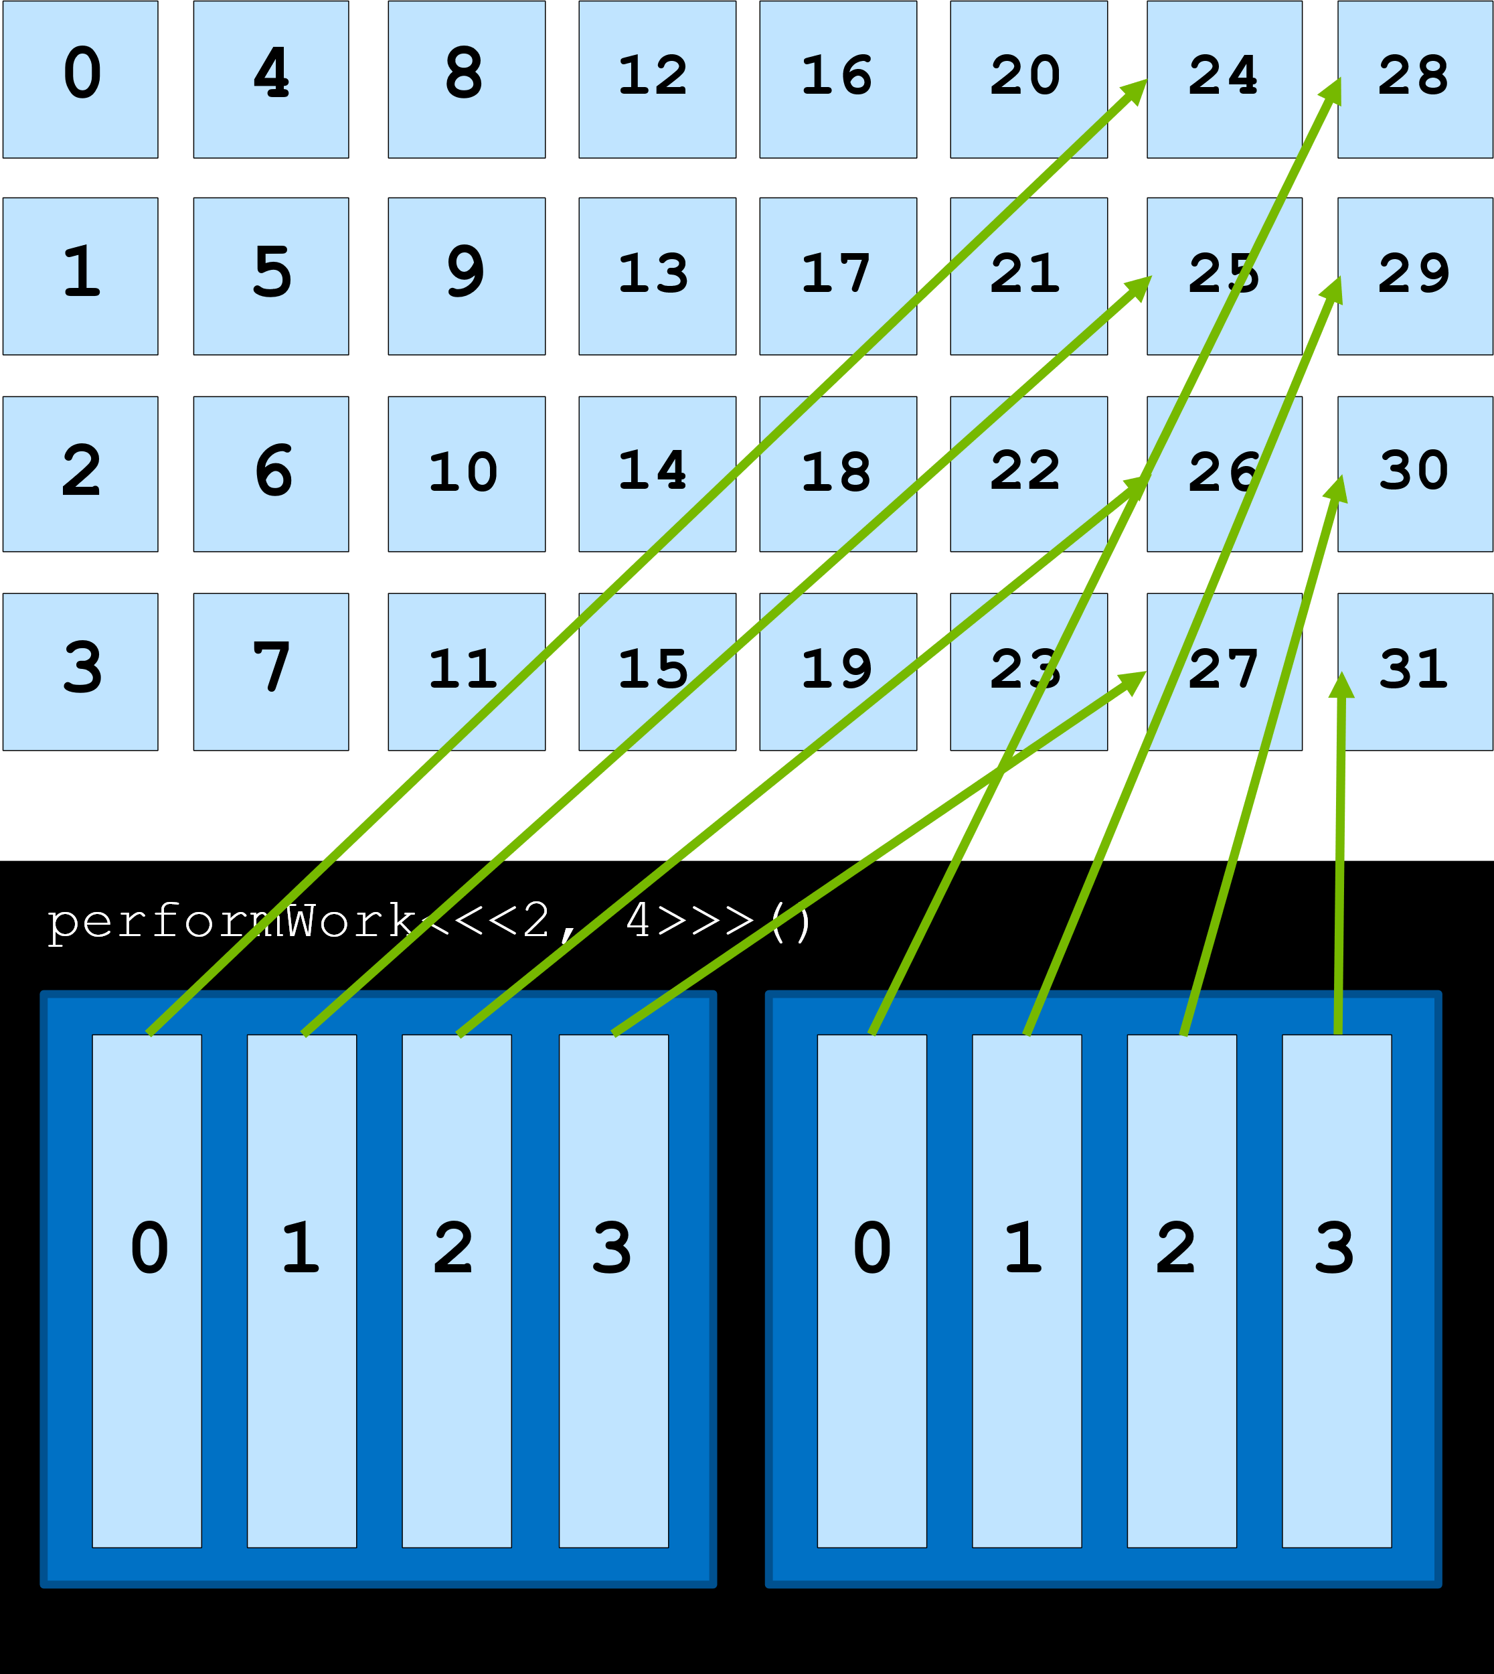
Data set larger than grid size: grid-stride loop
In this scenario, each threads should work on more elements.
Work can be assigned programmatically with a grid-stride loop:
the first element to be assigned to a thread is calculated via the global index,
the next one is obtained by summing the number of threads in the grid
stride = blockDim.x * gridDim.x
Notes:
Register = small amount of fast storage

Slide 24
Data set larger than grid size: grid-stride loop
Example: for an array with 1000 elements and a grid with 250 threads, each thread in the grid will need to be used 4 times.
Operation inside the kernel will be executed in a grid-stride loop:
__global__ void kernel(int *a, int N) {
int indexWithinTheGrid = threadIdx.x + blockIdx.x * blockDim.x;
int gridStride = gridDim.x * blockDim.x;
for (int i = indexWithinTheGrid; i < N; i += gridStride)
{
// do work on a[i];
}
}
Notes:
Register = small amount of fast storage

Slide 25
Exercise: 9_grid_stride_loop.cu
This code initialize on the CPU a vector of 10k elements. Then launch a kernel to double its value on GPU and finally perform a check to test values correctness on CPU.
Here the size of vector is bigger than the grid.
Refactor the kernel to use a grid-stride loop, so that each parallel thread works on more than one element of the array.
What is the size of the grid?

Slide 26
Error handling

Slide 27
Catching errors in CUDA
Error handling in accelerated CUDA code is essential.
Most CUDA functions return a value of type cudaError_t, which can be used to check if an error occurred while calling the function.
If its value is cudaSuccess no error occurred.
Other an error message can be printed with cudaGetErrorString.
cudaError_t err;
err = cudaMallocManaged(&a, N)
if (err != cudaSuccess) {
printf("Error: %s\n", cudaGetErrorString(err));
}
Notes:
Register = small amount of fast storage

Slide 28
Kernel launch errors
Kernel are defined to return void, so they do not return a value of type cudaError_t.
Example: launch configuration is erroneous.
cudaGetLastError function return a value of type cudaError_t can be used to catch kernel errors.
someKernel<<<1, -1>>>();
cudaError_t err;
err = cudaGetLastError();
if (err != cudaSuccess) {
printf("Error: %s\n", cudaGetErrorString(err));
}
Notes:
Register = small amount of fast storage

Slide 29
Asynchronous errors
To catch errors that occur in asynchronous part of the code (for example during the execution of an asynchronous kernel), check the status returned by a subsequent synchronizing CUDA runtime API call, such as cudaDeviceSynchronize
cudaError_t asynchErr;
asynchErr = cudaDeviceSynchronize();
if (asynchErr != cudaSuccess) {
printf("Error: %s\n", cudaGetErrorString(err));
}
Notes:
Register = small amount of fast storage

Slide 30
Macro
A macro that wraps CUDA function calls for checking errors could be useful.
Can be wrapped around any function that returns a cudaError_t.
#include <stdio.h>
#include <assert.h> inline cudaError_t checkCuda(cudaError_t result) {
if (result != cudaSuccess) {
fprintf(stderr, "CUDA Runtime Error: %s\n", cudaGetErrorString(result));
assert(result == cudaSuccess);
}
return result;
} int main() {
[…]
checkCuda( cudaDeviceSynchronize() )
}
Notes:
Register = small amount of fast storage

Slide 31
Exercise: 10_failing_double.cu
This code doubles the value of an array initialized on CPU, by launching a GPU kernel. Finally, a test on value correctness is performed on CPU.
This time the code has an error, and it prints that the elements of the array were not successfully doubled.
Refactor the application to handle CUDA errors: find the error(s) and fix it (them). Investigate both synchronous errors potentially created when calling CUDA functions, as well as asynchronous errors potentially created while a CUDA kernel is executing.

Slide 32
References

Slide 33

References
Previous editions of this school at CINECA
Oakridge National Laboratory’s “Introduction to CUDA C++”: https://www.olcf.ornl.gov/calendar/introduction-to-cuda-c/
NVIDIA DL Institute Online Course: main source of exercises
blogs.nvidia.com
Wikipedia

Slide 34
THANK YOU!
Lara Querciagrossa
l.querciagrossa@cineca.it

